Slide 1
kdevops: bringing devops to Linux kernel development
https://github.com/mcgrof/kdevops
Linux Plumbers Conference, August 26, 2020
Virtual conference
Luis Chamberlain - @mcgrof
mcgrof@suse.com / mcgrof@kernel.org

Slide 2
kdevops
Framework to configure, bring up target hosts, and run Linux kernel development workflows using modern devops infrastructure

Slide 3
We’ll cover
Original motivations
Bring up gap
Command and control and what I mean by that
What we have today with kdevops
What’s next in kdevops

Slide 4
Original motivation
Reduce the amount of time it takes to stabilize a new Linux filesystem

Slide 5
Key concepts review
What is a baseline?
What’s a new filesystem anyway?
  Is btrfs new?
    btrfs is now 13 years since it was merged on Linux: January 26, 2007

Slide 6
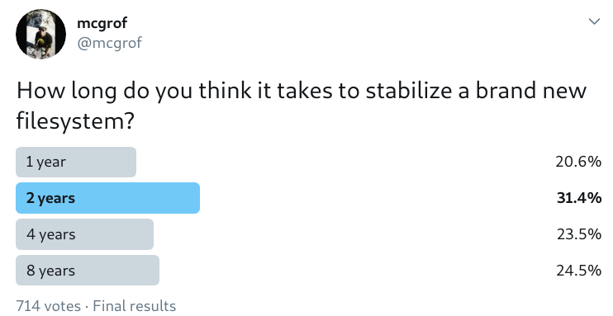
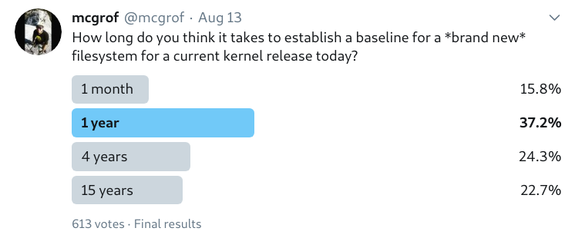
Ask around: ~ about 10 years, give or take !

Slide 7
Understand then divide and conquer
Why does it take so long?
Stable means no issues?

Slide 8
The dangers of tribal knowledge
None to little documentation
Difficult for new developers to ramp up

Slide 9
fstests
/var/lib/xfstests/configs/$(hostname).config
[default]
TEST_DEV=/dev/loop16
TEST_DIR=/media/test
SCRATCH_DEV_POOL="/dev/loop5 /dev/loop6 /dev/loop6 /dev/loop7 /dev/loop8 /dev/loop9 /dev/loop10 /dev/loop11"
SCRATCH_MNT=/media/scratch
RESULT_BASE=$PWD/results/$HOST/$(uname -r)
[btrfs]
FSTYP=btrfs
MOUNT_OPTIONS="-o discard,enospc_debug"
MKFS_OPTIONS="-f "
LOGWRITES_DEV=/dev/loop15
[xfs]
MKFS_OPTIONS='-f -m crc=1,reflink=0,rmapbt=0, -i sparse=0'
USE_EXTERNAL=no
LOGWRITES_DEV=/dev/loop15
FSTYP=xfs

Slide 10
oscheck
Strives to make running fstests as easy as possible
Shell wrapper around fstest’s own check script
Split up testings on XFS by sections, one per mkfs params
Tracks expunges per filesystem per kernel release and for distributions, per section
Scripts to install dependencies handling (now replaced)
Lacked bring up:
  Setting test environment should be easy

Slide 11
The oscheck gap
On Sat, Jul 14, 2018 at 03:21:15PM -0700, Matthew Wilcox wrote:
> On Fri, Jul 13, 2018 at 01:59:31PM -0700, Luis R. Chamberlain wrote:
> I feel like we need to merge ktest and oscheck.
In the end I disagreed.
> oscheck assumes that y
> know how to set up qemu, and ktest takes care of setting up qemu for you.
I really disliked all the stupid hacks we had both in mine and Kent's
solution. So I wrote a proper modern devops environment for Linux kernel
development which is agnostic from an architectural perspective to
your OS, and virtualization environment, whether that be local or cloud.

Slide 12
The bring up gap
Everyone has their own set of qemu scripts
  ktest
  rapido
  kvm-tests
OS preference dilema
  Linux
  Mac OS X
  Windows
Virtualization tech:
  KVM
  Virtualbox
Only one cloud solution
  Ted’s xfstests-bld: GCE based though
  What about the others:
    Azure
    AWS
    OpenStack

Slide 13
Command and control design goals
Optionally extend your ~/.ssh/config with your provisioned nodes
Optionally add your preferred ~/.gitconfig and/or favorite bash hacks to nodes
Install workflow dependencies
Run target workflow on each node
Collect results and show them in a reasonable way

Slide 14
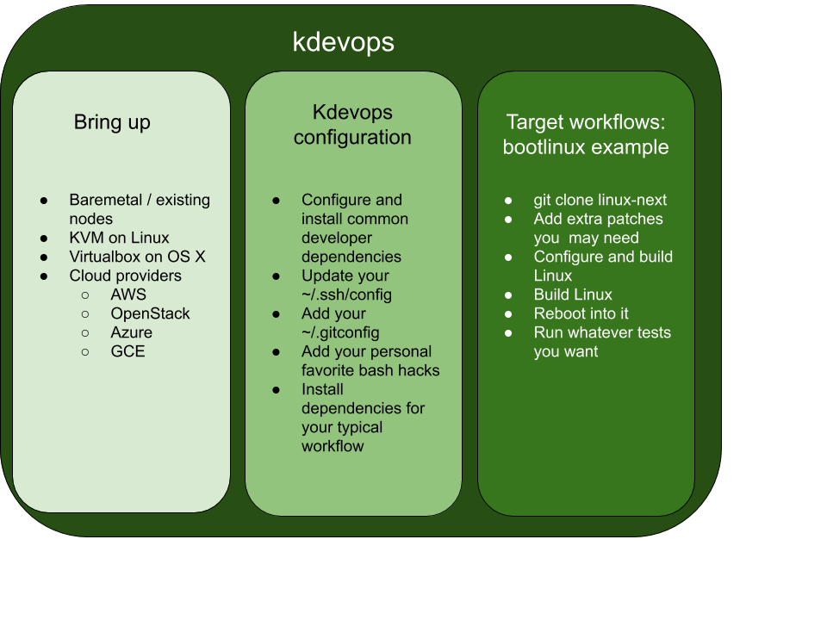

Slide 15
Tools used by kdevops
Vagrant
Terraform
Ansible
The Linux kernel modeling variability language: kconfig

Slide 16
Example complex workflow: fstests
make menuconfig
make deps
make bringup
make linux
make fstests
make fstests-baseline

Slide 17
Display regressions
git diff

Slide 18
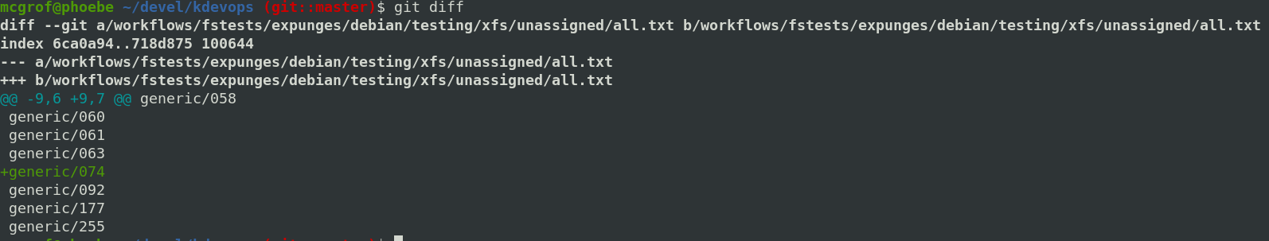
Display regressions

Slide 19
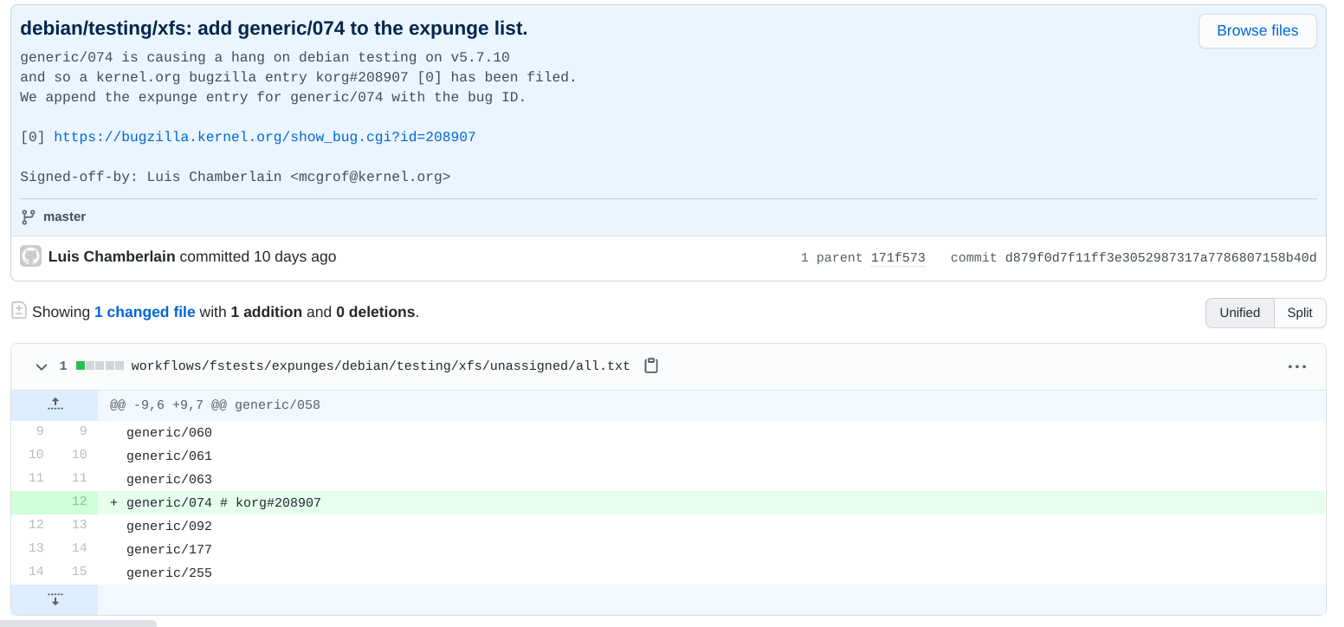

Slide 20
Lessons learned
Terraform should only stick to mini provisioning
  Many ansible roles can be used later
  Any error on an ansible role on bring up tied with terraform would yield an issue with bringup
Post bring up, you should allow ansible to do the rest
Kconfig saved the day
Ansible helps slowly parallelize unparalleled frameworks

Slide 21
What’s next
Auto baseline generator for new kernels for existing filesystems
Other workflows to add:
  blktests
  Linux kernel selftests
  Kunit?
Commoditize filesystems testing
  How much does it cost to run fstests against a baseline on a cloud?
Yes containers
Move certain fstests / blktests tests to kunit if possible

Slide 22
Questions?

